Slide 1

Flavors of the Pharmaverse
WiFi: Posit Conf 2024
Password: conf2024

Slide 2
Information
WiFi: Posit Conf 2024
Password: conf2024
There are gender-neutral bathrooms located on levels 3,4,5,6 &7
The meditation/prayer room is located in 503
Available Monday & Tuesday 7a.m. - 7p.m., Wednesday 7a.m. - 5p.m.
The lactation room is located in located in 509
Available Monday & Tuesday 7a.m. - 7p.m., Wednesday 7a.m. - 5p.m.

Slide 3
Conduct
Participants who do not wish to be photographed have red lanyards; please note everyone's lanyard colors before taking a photo and respect their choices.
The Code of Conduct and COVID policies can be found at: https://posit.co/code-of-conduct/.
Please review them carefully.
You can report Code of Conduct violations in person, by email, or by phone. Please see the policy linked above for contact information.

Slide 4
What to expect from this workshop
Learn about what the Pharmaverse is
R packages to support Clinical Reporting in R
Create ADaM datasets from SDTM
Multiple ways to create tables
Learn about ARD’s
Hands-on Exercises & Discussions

Slide 5

Workshop Expectations
What to do if you find a ?
Ask questions!
Be respectful to each other and yourself

Slide 6
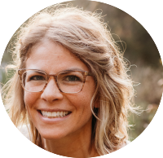
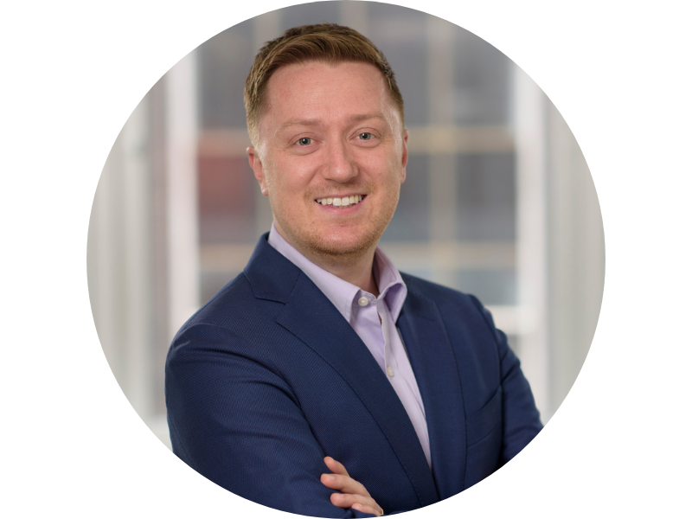

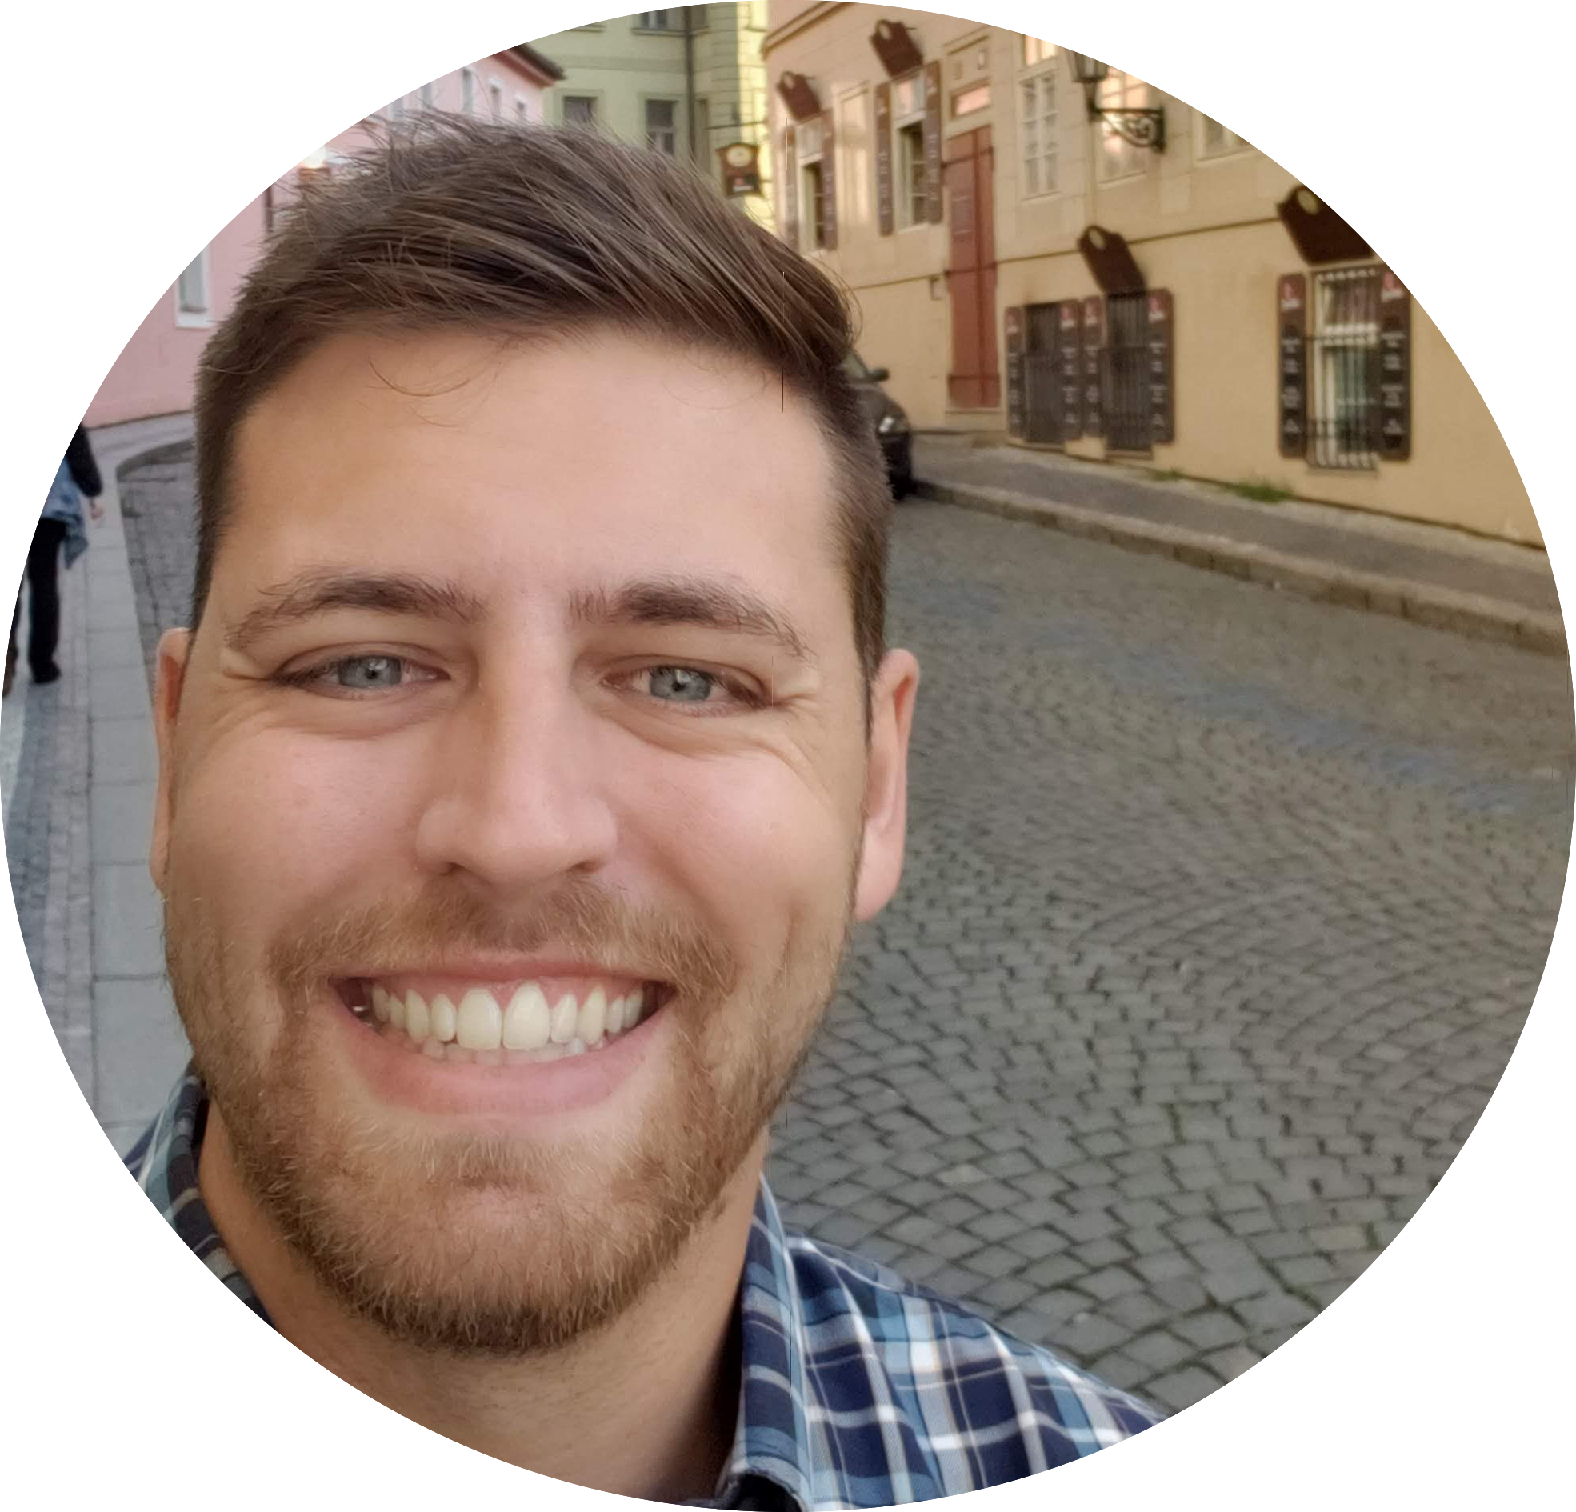
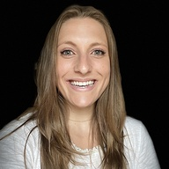
Workshop Instructors
Becca Krouse
Daniel Sjoberg
Andrew Bates
Who are we?
What do we do?
Why are we here?
Ellis Hughes
Casey Aguilar-Gervase

Slide 7

Who are you?!
Meet the people around you!

Slide 8
Who are you?! Now we want to meet you!
R Experience?
Never used R?
2 years
5 years
Used Tidyverse?
Used Pharmaverse Packages?
Pharma Experience
CDISC
TLF Generation
validation

Slide 9
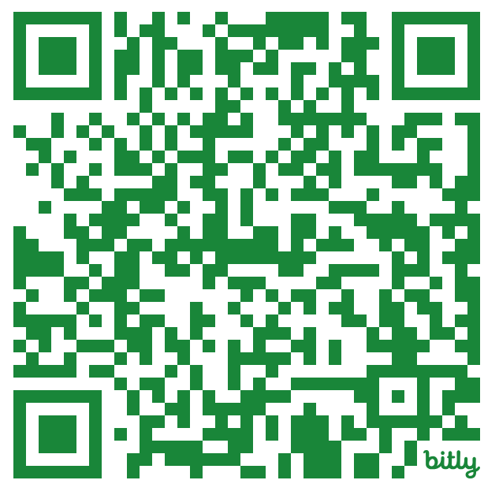

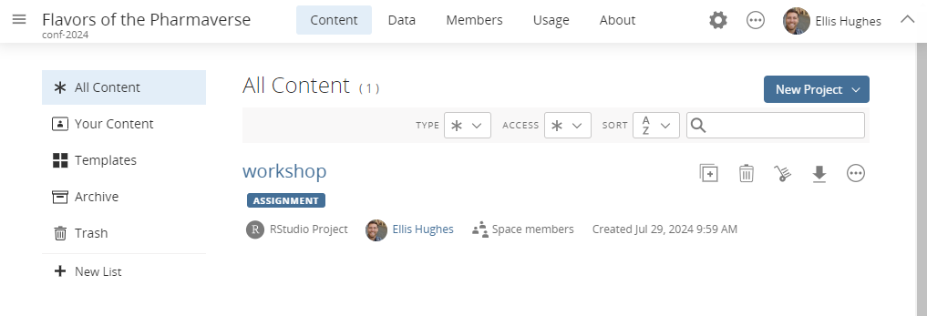
Our environment:
For consistency, we’ll be working in Posit Cloud (https://bit.ly/posit_2024_Pharmaverse)
We’ve installed and configured everything for you
Following the course, all content from this workshop will be available on GitHub (https://github.com/posit-conf-2024/pharmaverse)

Slide 10
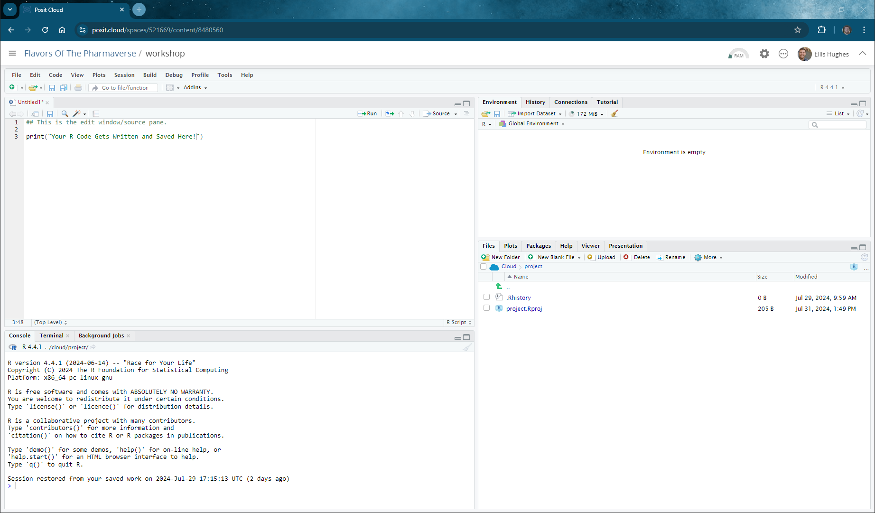

Slide 11
Edit Window/Source

Slide 12

Console

Slide 13
File Pane

Slide 14
Plot Pane

Slide 15
Help Pane

Slide 16
Environment

Slide 17
Time | Activity
09:00 – 09:20 | Introduction & Welcome to the Pharmaverse
09:20 - 10:30 | Session 1 – ADaM
10:30 - 11:00 | Coffee break
11:00 - 12:30 | Session 2 – Tables & ARD Intro
12:30 - 13:30 | Lunch break
13:30 - 15:00 | Session 3 – ARD Based Tables
15:00 - 15:30 | Coffee break
15:30 - 17:00 | Session 4 – Recap and Discussion

Slide 18


Welcome to the Pharmaverse
(Welcome To The Jungle starts playing somewhere off in the distance…)

Slide 19
Pharmaverse
https://pharmaverse.org/
Goals
Align pharma industry on a set of open source packages based in R to deliver the clinical data pipeline
Design, collaborate, and deliver new solutions where suitable tools do not exist (ie admiral)

Slide 20







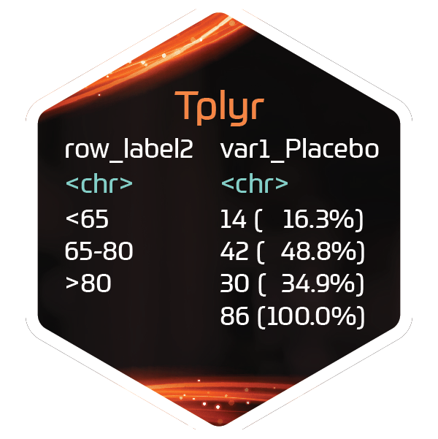










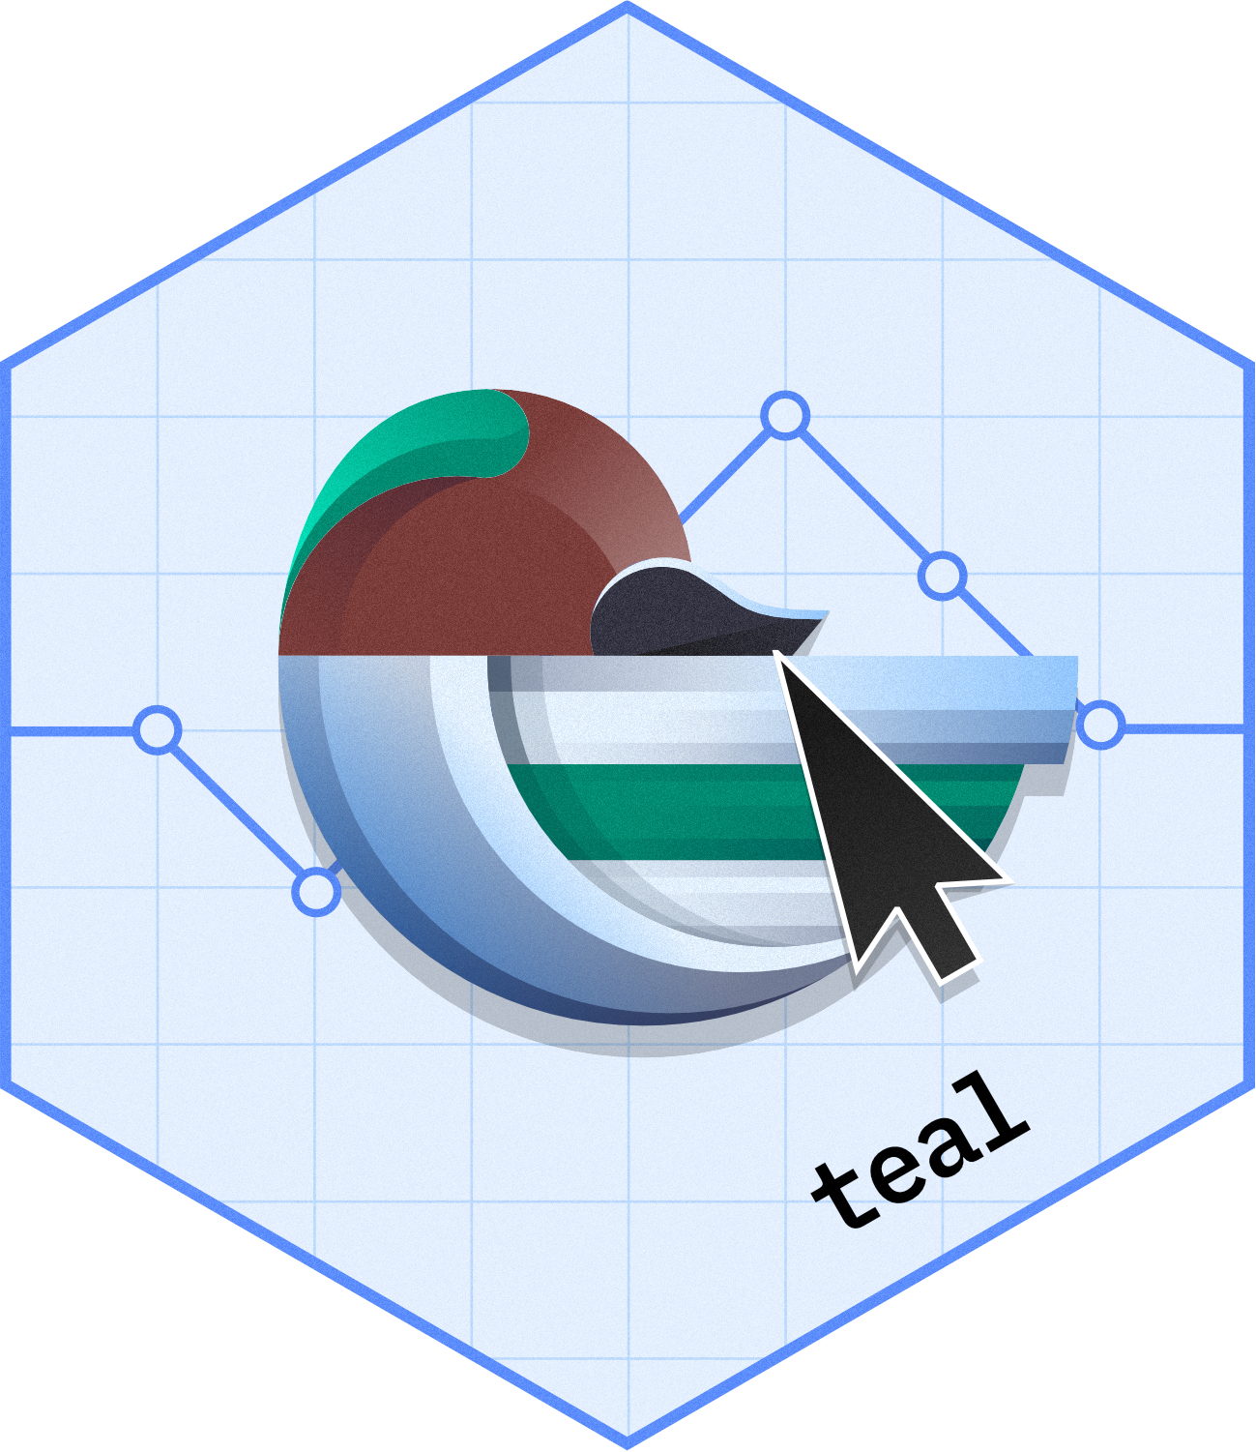


E2E Clinical Reporting Packages
https://pharmaverse.org/e2eclinical/

Slide 21
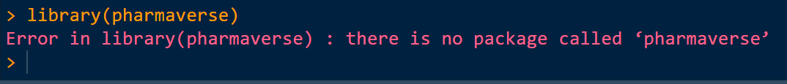
Not to give anyone ideas, but it is not a “verse” like tidyverse

Slide 22
Industry working on a similar goal
Standards (ie CDISC) means standard tools can be created and shared
Collaboration in the “post competitive” space means everyone has access to free solutions
Team and Regulators seeing consistent packages being used across multiple teams speeds up development and review

Slide 23
TRUE or FALSE?
Pharmaverse makes decisions on how R should be used in the pharma space
Pharmaverse serves as a source of information on available R packages that help with the Clinical Data Workflow
Pharmaverse allows commercial interests from Collaborators to drive decisions
The scope of Pharmaverse starts at STDM and ends at TLF creation
Pharmaverse does not require you to be part of it use the tools coming from it
Pharmaverse packages need to be reviewed by your own GXP process
FALSE
TRUE
FALSE
FALSE
TRUE
TRUE

Slide 24
Resources
Website:
Pharmaverse.org
R packages and github
https://github.com/pharmaverse/
Youtube Channel
https://www.youtube.com/channel/UCxQFEv8HNqM01DXzdQLCy6Q
Blog
https://pharmaverse.github.io/blog/
Community
pharmaverse.slack.com

Slide 25
Lets get started into the Pharmaverse!

